Slide 1
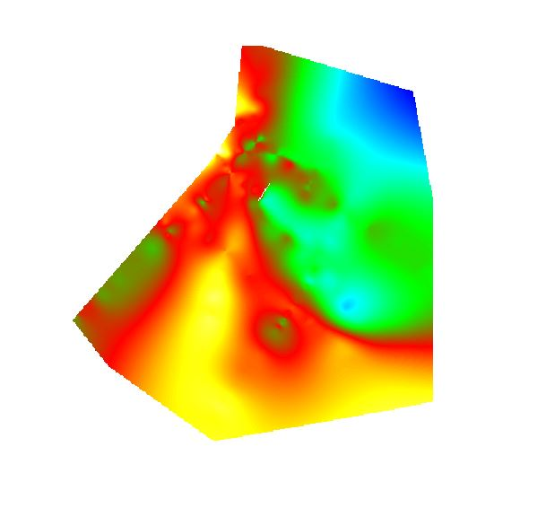
Identifying the southern margin of the Judea graben
Research Report Presentation submitted to the Department of Natural Sciences in the Open University of Israel
By: Gidi Yoffe
For course 20575 “פרויקט מחקר בגיאולוגיה” (“Research project in the field of Geology”)
June 2017

Slide 2
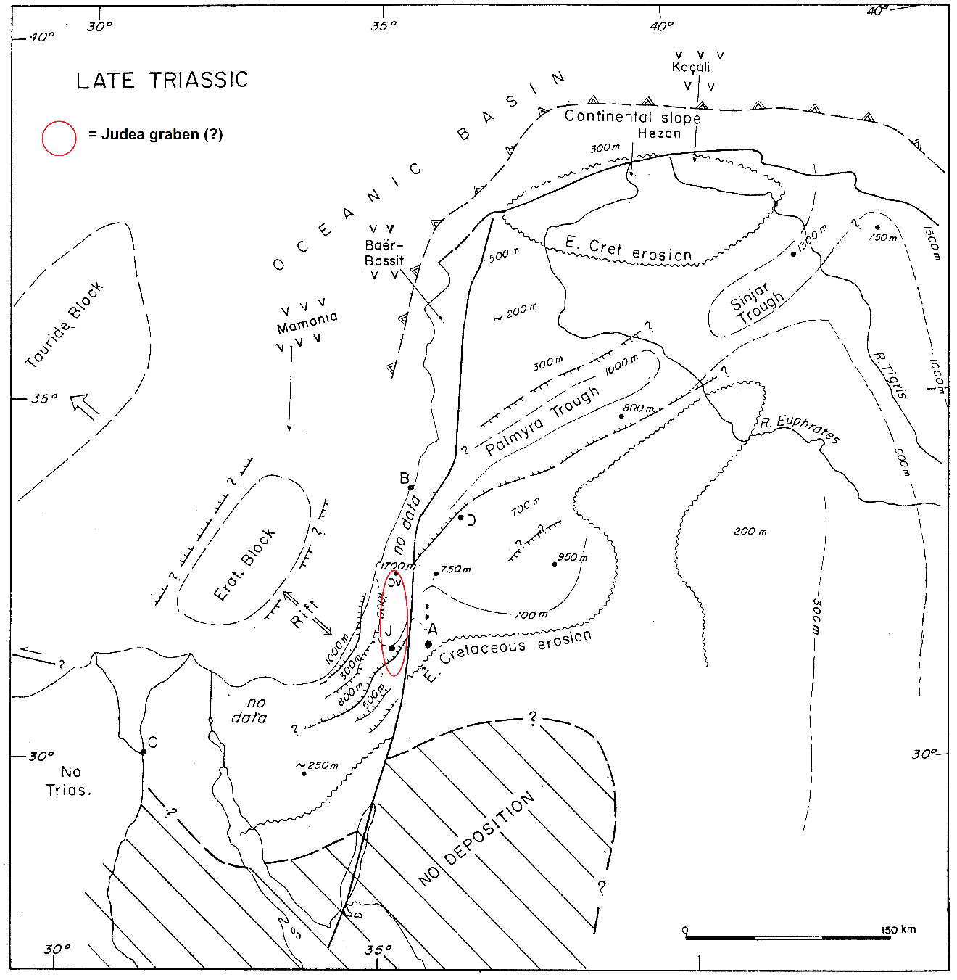
Geological Introduction
Rifting activity in the Levant region started in the late Permian and continued in several pulses through the Triassic and Early to Mid-Jurassic. Significant vertical movements and differential block motions took place during this period, which created an extensive graben and horst system extending east of the Mediterranean coastline.
A major structural low extends in a NW-SE direction from northern Sinai to central Israel - the Hilal and Judea grabens. The Judea graben is a sub-structure of the larger Palmyride Fold Belt which also evolved during this period.
Permo-Triassic shallow-marine section accumulated in a large N-S oriented embayment, roughly coinciding with today’s Judean highlands. The section thickens gradually to the north and thins to the east and west. The thickness variations in the Triassic section reflect a regional northward dip of the basement and local vertical motions.
From: Garfunkel (1998)

Slide 3
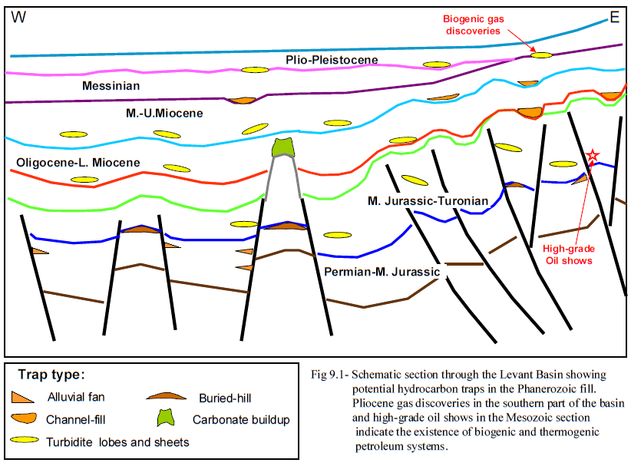
Hydrocarbon Potential
Triassic Carbonate Layers comprise large hydrocarbon reservoirs throughout Mesopotamia – in Syria, Iraq, Saudi Arabia and Iran.
Such layers which contain Oil and Gas, are usually blocked by layers of Anhydrite and are considered to comprise up to 20% of today’s hydrocarbon reserves.
Onshore Israel, multiple drilling attempts were made during the past decade to identify such Triassic layers that may contain hydrocarbons, based
From: Gardosh et al. (2008)
on the assumption that the Palmyride trough – a hydrocarbon-rich Triassic structure located mainly in Syria continues to the west of the Dead-sea Transform and forms a structure which today is called the Judea graben.
By examining the Triassic stratigraphic record of RAMALLAH-01, DEVORAH-02, MEGED-02, GA’ASH-02 and HELEZ-DEEP wells, the western margin of the Judea graben was constrained by horst structures (Ga’ash and Ma’anit highs).

Slide 4
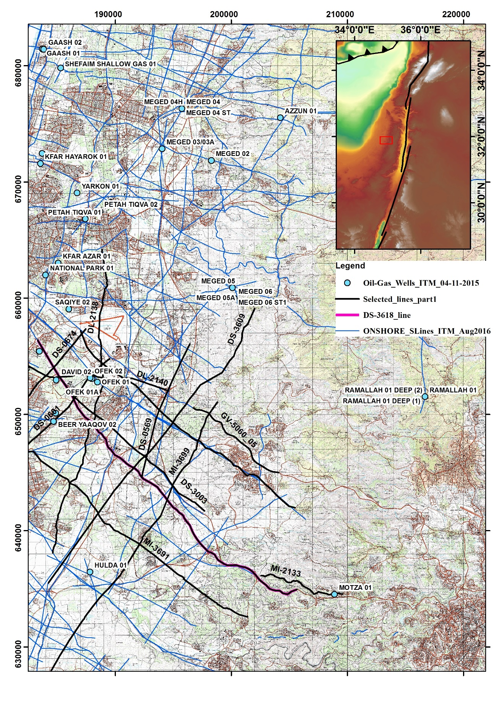
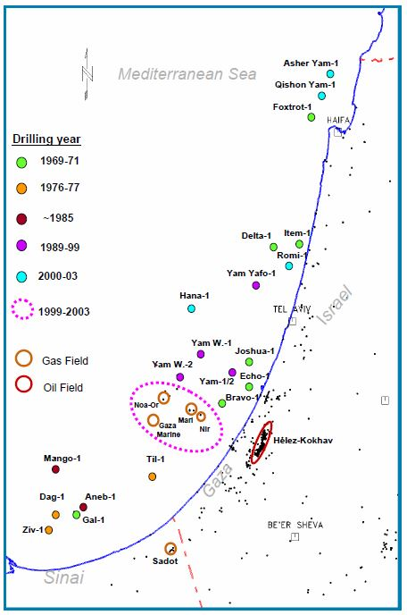
Aim of Research
Despite the western margin of the Judea graben being relatively well defined, scarce evidence of its extension southward exists due to the absence of wells that penetrated the Triassic section and seismic surveys that were conducted in that area.
The aim of this study, through interpretation of existing seismic data and its correlation with well data is to examine the extension of the Judea graben to the south-west of RAMALLAH and MEGED wells and determine, if possible, whether the structure converges to a closure.
From: Gardosh et al. (2008)

Slide 5
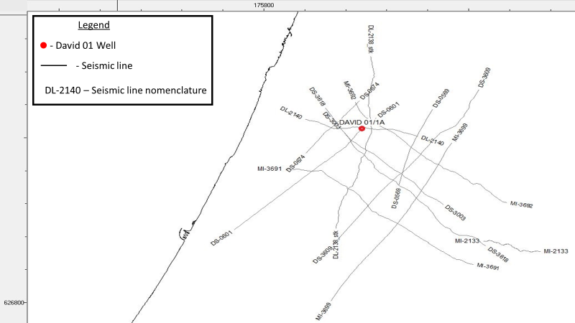
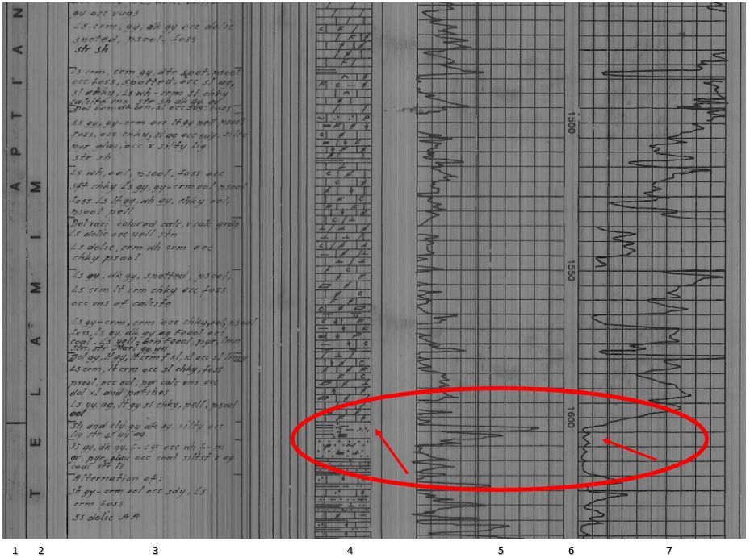
Data sets
12 multi-channel 2D seismic reflection surveys were used for interpretation. The surveys were acquired in the framework of hydrocarbon exploration during the timeline of 1970-1990, comprising a cumulative length of 258 kilometers The area encompassed by these surveys covers the Judean coastal-plain from Ashdod in the south to Rishon-LeZion in the north. All seismic data was provided in the time-domain.
DAVID-01 well, which penetrated Triassic layers and is located within the area of study, provided a key component in tying seismic data to lithology. The well was logged for different types of data – Lithology, electrical resistivity and seismic velocity of interval-layers, all of which were measured in relation to depth.
Chronostratigraphic and Structural maps were used as a measure of guidance during the interpretation process.

Slide 6
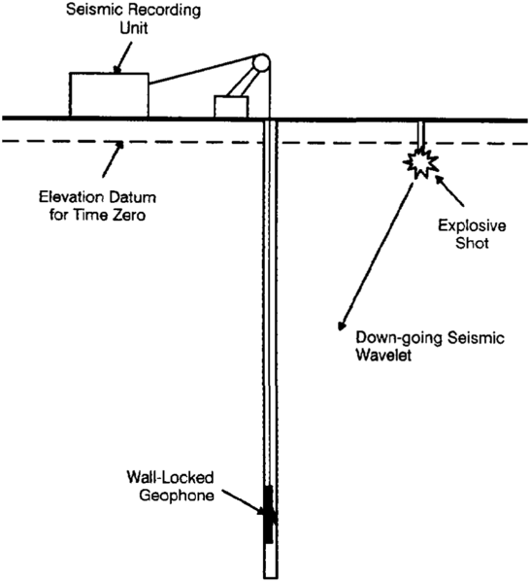
Methodology
In order to correlate seismic data with true depth and corresponding geological units provided in well-log data, a time-to-depth conversion process is necessary.
Seismic data is measured in the time it takes for a seismic wave to reach a reflector and return to the geophone (two-way time). Therefore, velocities of the acoustic waves are required to tie well-log data to seismic data.
Time-to-depth conversion has been achieved by the calibration of the seismic line DL-2140 with a Seismic Velocity Survey conducted in DAVID-01 well, which is meant produce a down-going seismic wavelet at the surface near the well and then to measure the time required for that wavelet to travel to a known depth where a seismic receiver is positioned in the well. Repeating this process while positioning the receiver at different depths provides a curve of seismic velocities of known intervals. Then, 5 prominent seismic reflectors were attributed to geological units and interpreted laterally.
Line DL-2140
Near-top Yakhini
Near-top Yagur
Near-top Daya
Near-top Mohilla
Near-top Ra’af

Slide 7
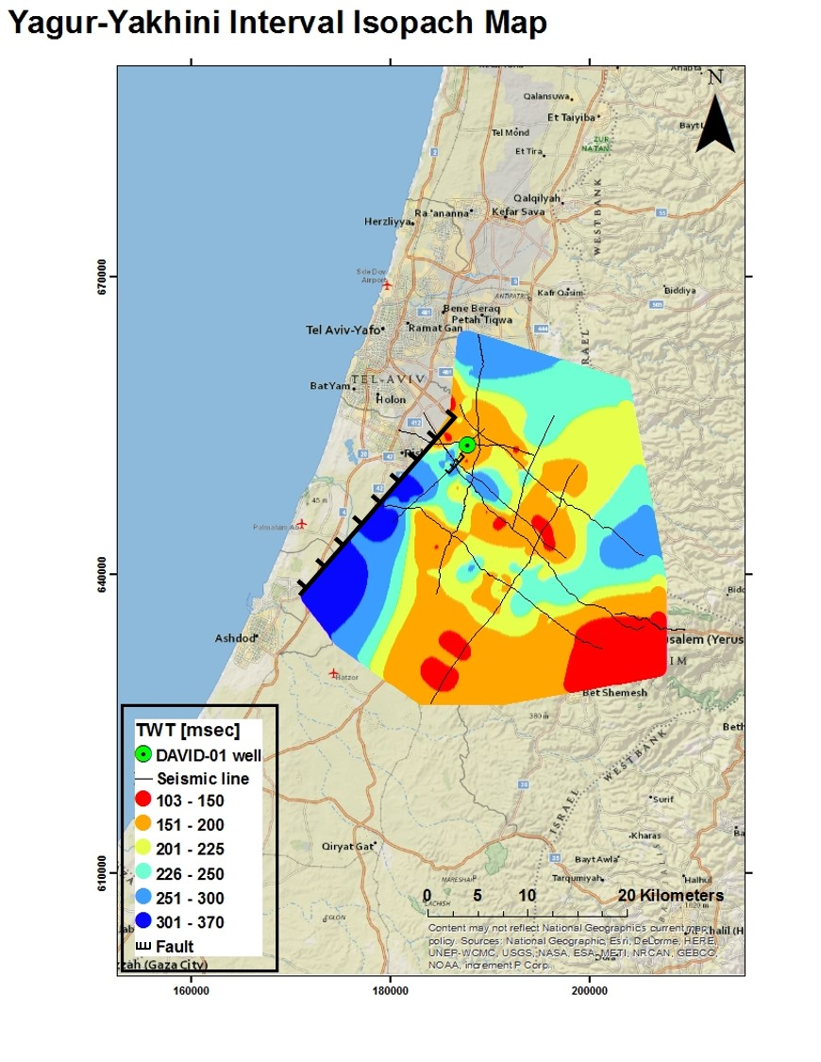
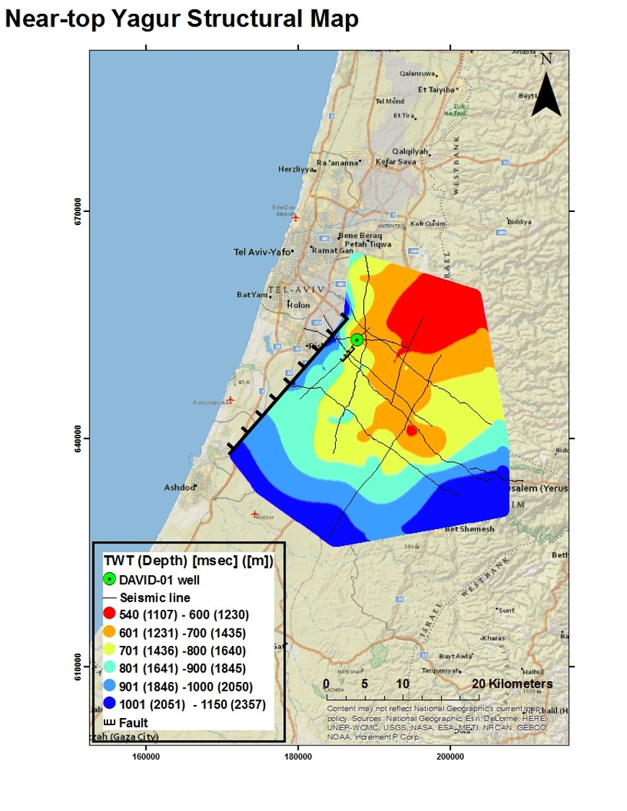
Results
5 seismic horizons which were tied to formation-tops of geological units were interpreted laterally, and thus, a structural map of each horizon was generated in the time and depth domains. Such maps show the net deformation that the particular layer had undergone through time.
Additionally, 4 isopach maps were generated, representing thickness variations of interval-layers between two consecutive interpreted horizons. Those may imply on sedimentation trends…..

Slide 8
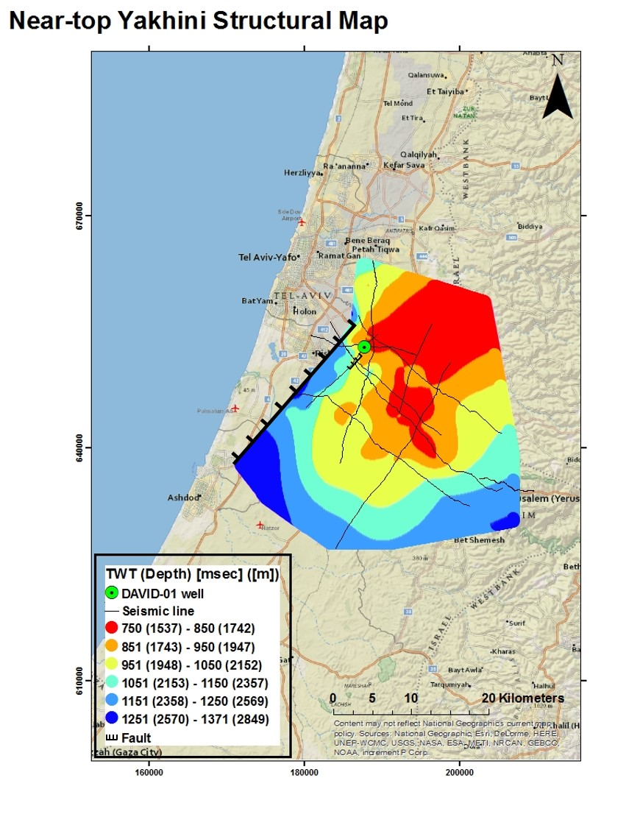
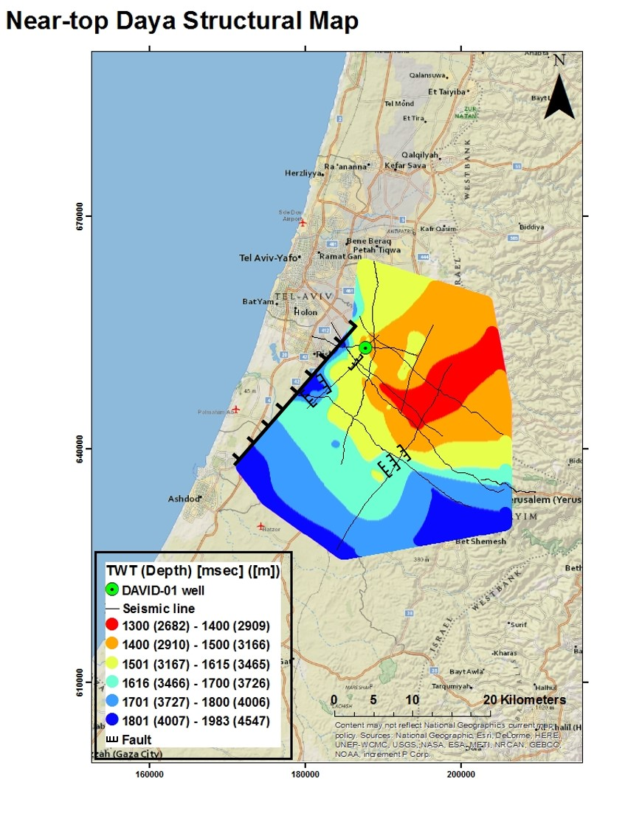

Slide 9
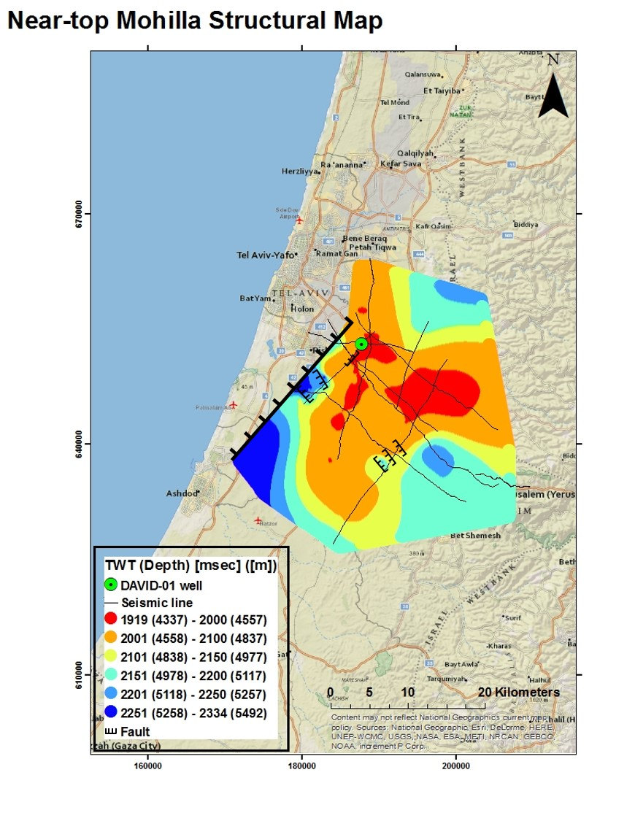
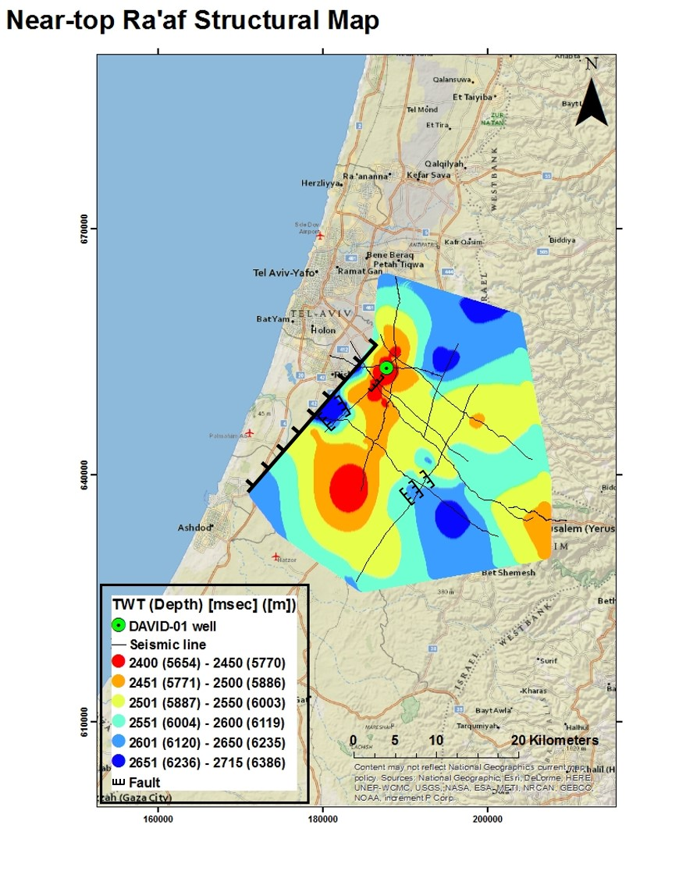

Slide 10
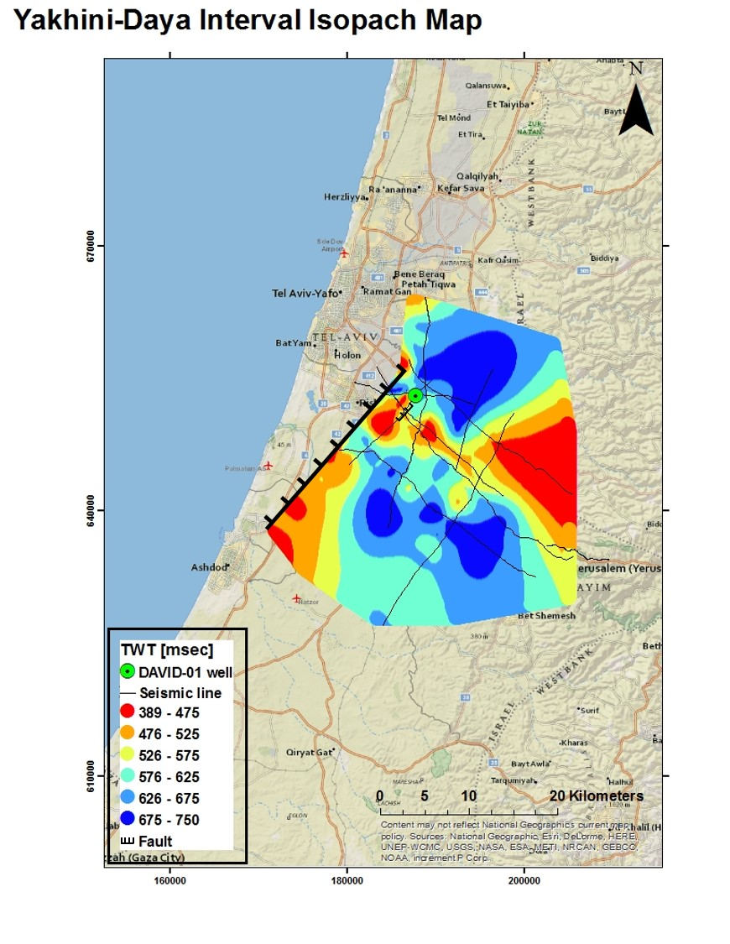

Slide 11
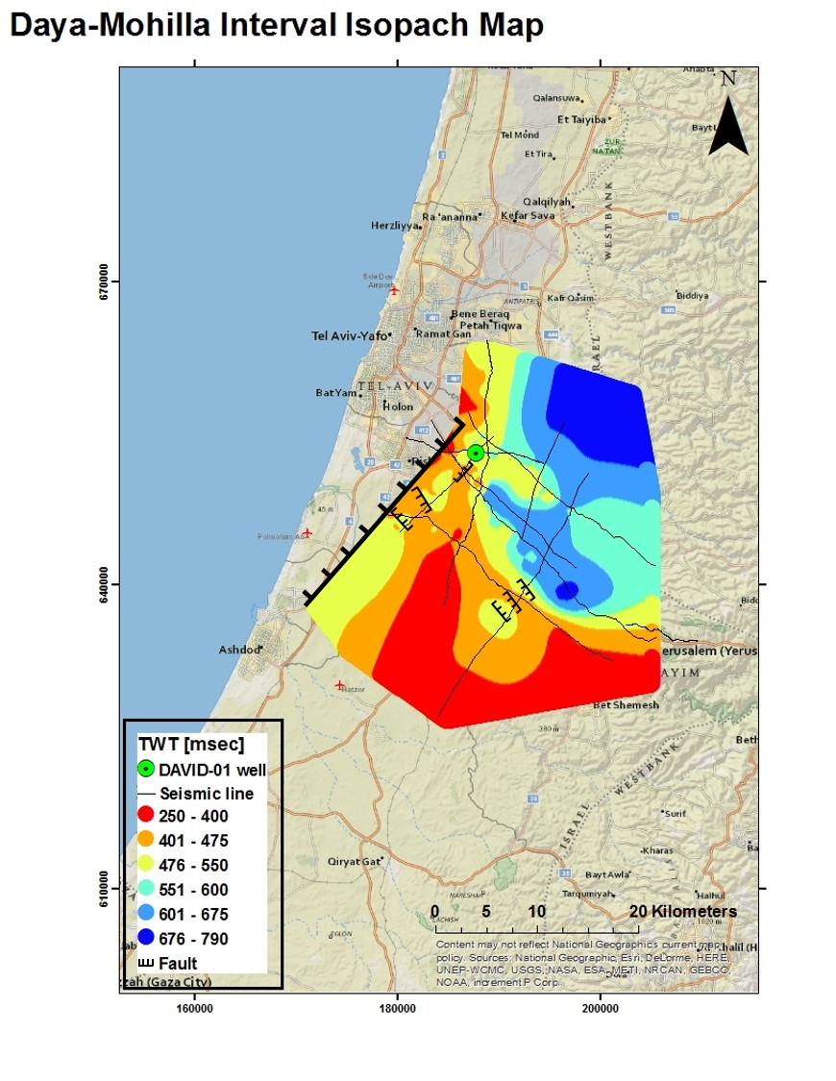
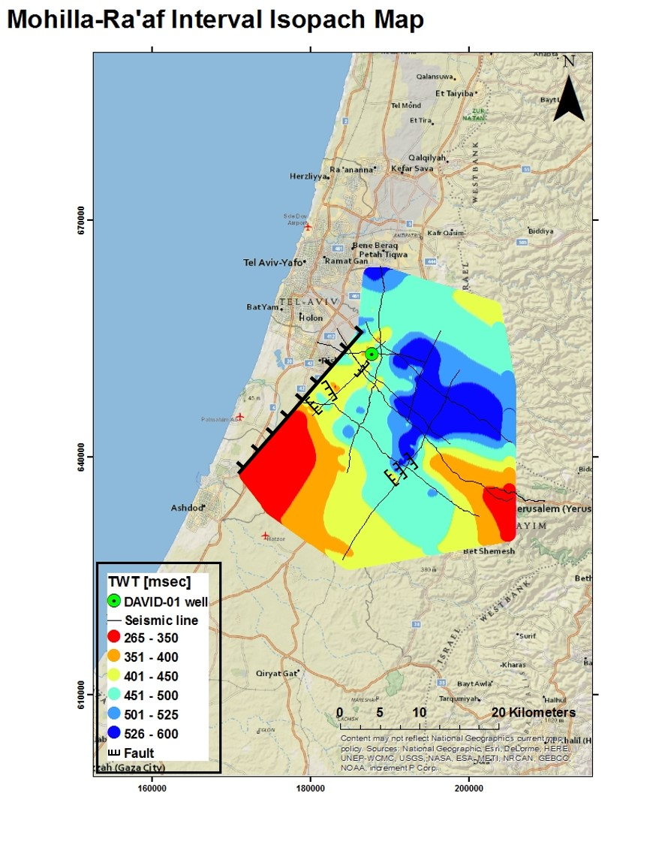

Slide 12
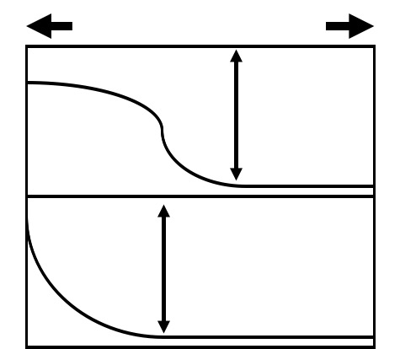
Discussion
Younger regime
Older regime
Two major tectonic regimes were identified in this study:
The younger, characterized by a north-east south-west strike and a dip westward, was identified in the three upper horizons – near-top Yagur, near-top Yakhini and near-top Daya. Time constraint applied to the beginning of this regime’s activity is set to at least from Albian time (Yagur frm.).
The older, identified in the lower near-top Mohilla and near-top Ra’af layers, no strike-dominated structural deformation was observed. However, a gradual deepening trend towards the south-east implies on a different or an additional, earlier regime causing the observed deformation. Maximal time constraint applied to this regime limits its activity to Mid-Jurassic time (~Bajocian) (base of Daya frm.). The deepening trend to the north-east roughly correlates with thickening of the Interval-layers at that area. Such correlation may imply on a sedimentary depo-center with a migration pattern due north-east with time.
S-W N-E
Daya-Mohilla
Interval layer
Jurassic Triassic
Mohilla-Ra’af
Interval layer

Slide 13
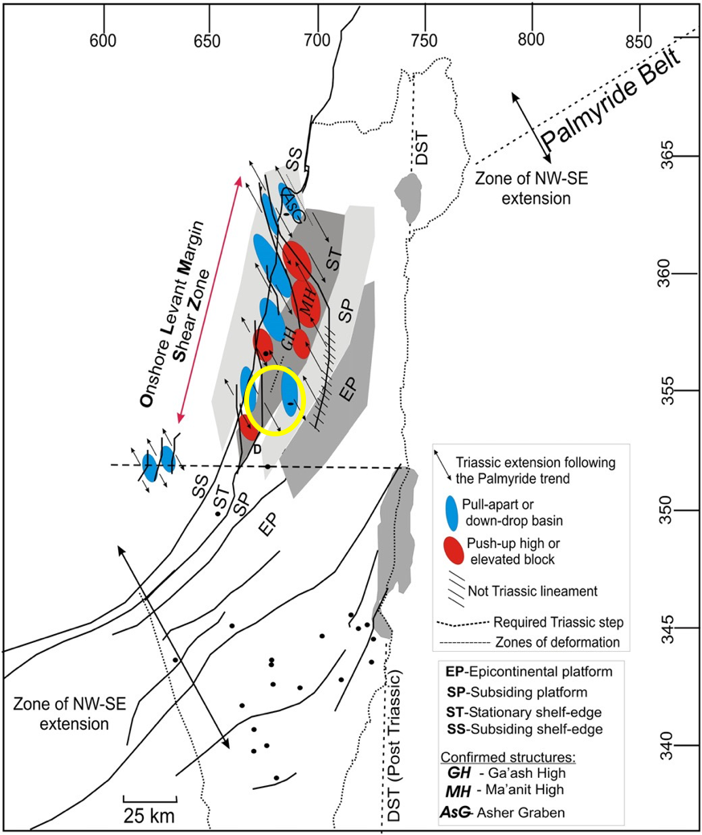
Comparison to Literature
(highlights)
The deformational pattern of the upper three layers (near-top Yagur, Yakhini and Daya) corresponds structurally and chronologically with the findings of Joseph-Hai et al., 2010 and Eyal., 2011, who attribute it to the Syrian Arc Fold Belt (Krenkel, 1924) of Upper Cretaceous time.
No specific structures can be definitely deduced due to the relatively low-resolution of this study. A correlation, however, exists between this structural regime and the findings of Goldberg and Friedman (1974); Druckman (1974, 1977); Freund et al. (1975); Druckman (1974); Gelberman and Kemmis (1987); Bruner (1991); Druckman et al. (1995a); Garfunkel (1998). These associated differential block motions and vertical movements that have created an extensive graben and horst system extending east of the Mediterranean coastline to late-Paleozoic to early-Mesozoic Rifting activity, caused by the opening of the Neotethys Ocean (Garfunkel and Derin, 1984; Garfunkel, 1998).
From: Korngreen et al. (2013)

Slide 14
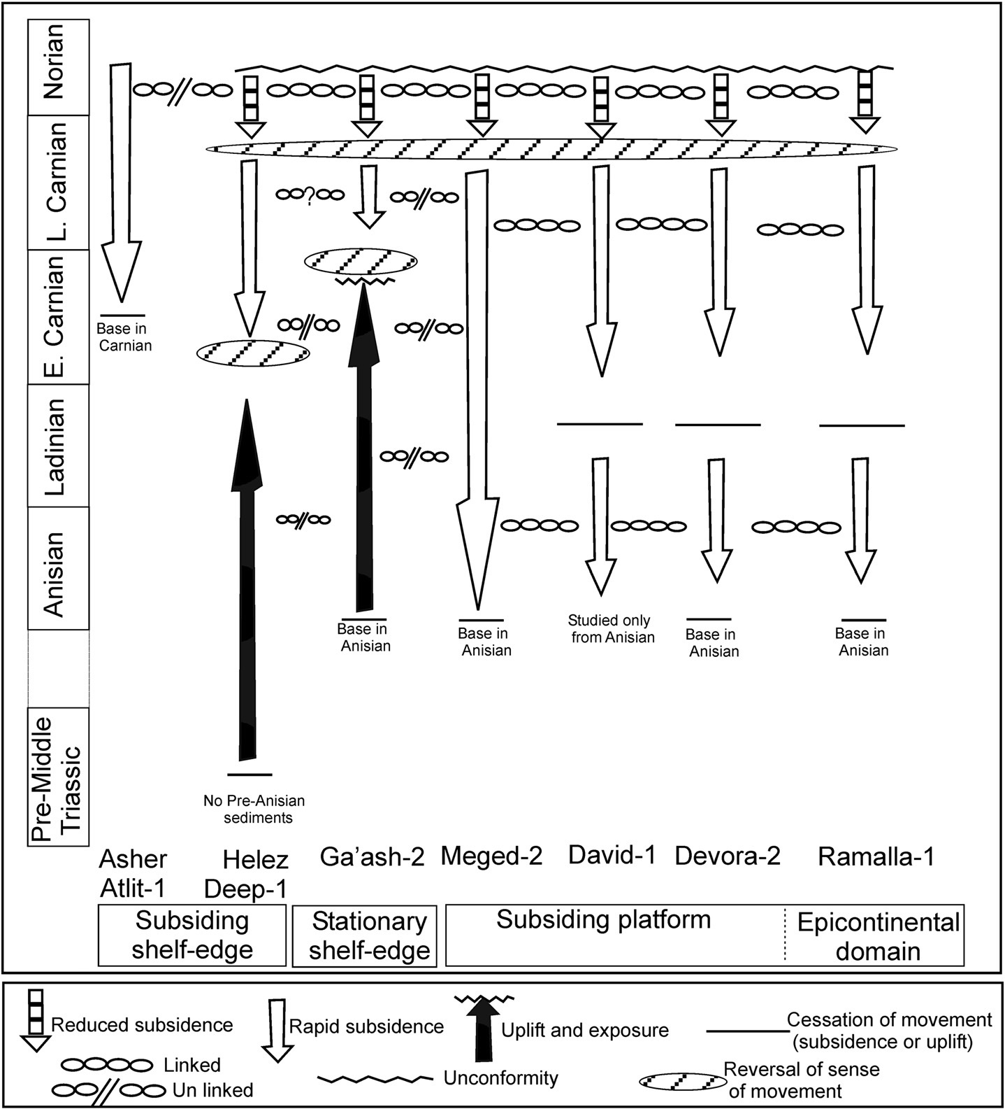
Both structural and thickness trends of the two lower layers (near-top Mohilla and Ra’af) correspond geographically with the findings of Korngreen et al. (2013), which tie the vertical differences of the sedimentary record of seven boreholes to Triassic tectonic activity. Moreover, Korngreen et al. (2013) place DAVID-01 well’s location at a western margin of a subsiding platform during the Triassic, which also correlates the findings of this study.
Thus, strong correlation to previous studies suggests that Neotethyan Rifting Activity, dating to mid-Triassic to early-Jurassic times is the main source of the deformation of near-top Mohilla and near-top Ra’af layers.
From: Korngreen et al. (2013)

Slide 15
Conclusions
With the method of seismic interpretation of 12 seismic lines, two tectonic regimes are associated with deformation of chosen layers within the studied area:
The younger - Syrian Arc Fold Belt, caused by the closure of the Neotethys, affecting mainly layers of the age ranging from mid-Jurassic to upper Cretaceous times, which in this study are represented by the chosen horizons of near-top Yagur (~Albian), near-top Yakhini (~Albian) and near-top Daya (~Bajocian). The characteristic trend of this regime is a north-east south-west striking folds with a westward dip.
The older - Neotethyan Rifting Activity of mid-Triassic to mid-Jurassic times, which in this study is represented by the near-top Ra’af (~Anisian) and near-top Mohilla (~Carnian/Norian) horizons. A deepening and thickening trend in the north-eastern area of the studied area of near-top Mohilla and near-top Ra’af layers, represents a Triassic-Jurassic subsided block with a sedimentary depo-center which migrates due north-east in time. Such a migration pattern may suggest that this structure is a westward extension of a greater graben-like structure extending to the north-east, thus possibly representing the south-western margin of the Judea graben.

